Slide 1


Deep Learning approach to Tomato Plant Diseases Recognition and related Sensitivity Analysis
Deep Learning approach to Tomato Plant Diseases Recognition and related Sensitivity Analysis
Milano, Luglio 2018
Deep Learning: Theory, Techniques and Applications
A.Y. 2017/2018
Alessandro Erba, Mirco Manzoni, Giuseppe Mascellaro

Slide 2
Proposed Workflow Approach
Transformations Selection
Transformations
Model Validation
Sensitivity Analysis and Performance evaluation
Model Selection
Validation
Data
Train-Test Split
Train
Augmentation and Normalization
Model Training
Train
Test
Normalization Values
Variations Application and Normalization
Hyper-parameters Choice

Slide 3
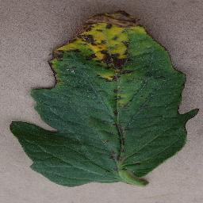
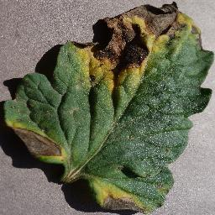
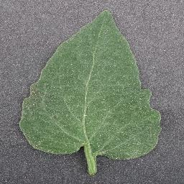
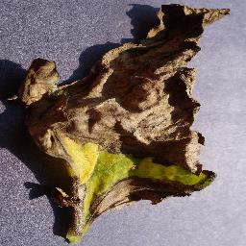
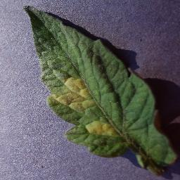
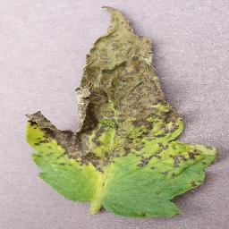
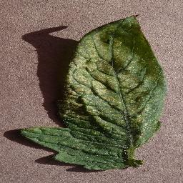
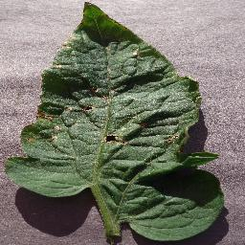
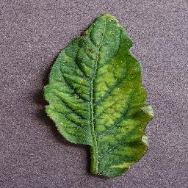
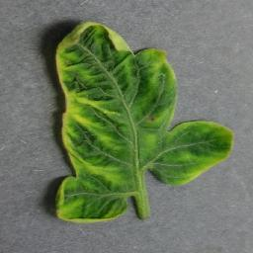
Dataset
Bacterial Spot
2.127 samples
Early Blight
1.000 samples
Healthy
1.590 samples
Late Blight
1.909 samples
Leaf Mold
952 samples
Septoria leaf spot
1.771 samples
Two Spotted Spider mite
1.676 samples
Target Spot
1.404 samples
Tomato Mosaic Virus
373 samples
Tomato Yellow Leaf Curl virus
5.356 samples

Slide 4
Data Augmentation and Normalization
Before the Training and Validation pahses data are augmented and Normalized.
Each sample is transformed taking two transformations from this pool:
Flip Top Bottom,
Flip Left Right,
Rotate 90°,
Rotate 180°,
Rotate 270°,
Flip Top Bottom and Rotate 90°,
Flip Top Bottom and Rotate 270°.
Data are normalized in two different ways:
Dataset Normalization
Per-leaf Normalization

Slide 5
Binary Classification - Setup
Healthy vs Infected
Architecture: LeNet
Xavier initialization
Rectified linear unit (ReLU) activation function
Binary cross-entropy Loss
Adam Optimizer
10-Fold cross Validation

Slide 6
Binary Classification - Results
Accuracy 99.92%
Precision 99.34%
Recall 99.67%
F1 - measure 99.5%
Confusion Matrix
TP = 300 | FN = 1
FP = 2 | TN = 3375

Slide 7
Multi-class Classification
AlexNet architecture
Train from scratch
Transfer Learning
Xavier initialization
Rectified linear unit (ReLU) function
Cross-entropy Loss
Adam Optimizer
Cross-validation

Slide 8
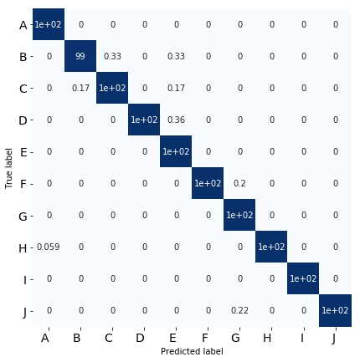
Multi-class Classification - Results
Accuracy: 99.85%
Macro precision: 99.83%
Macro recall (Trues Rate): 99.82%
Falses Rate: 0.18%
Macro F1: 99.83%
Bacterial Spot
Early Blight
Late Blight
Leaf Mold
Septoria Leaf Spot
Two-spotted Spider Mites
Target Spot
Tomato Yellow Leaf Curl Virus
Tomato Mosaic Virus
Healthy

Slide 9
Multiclass Classification - Training accuracy with different setup

Slide 10
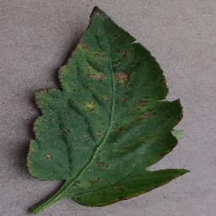
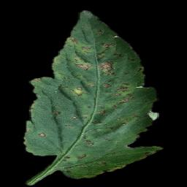
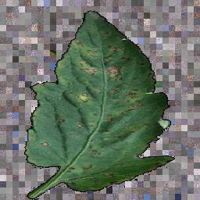
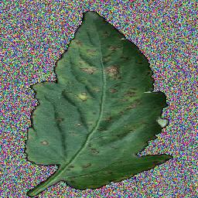
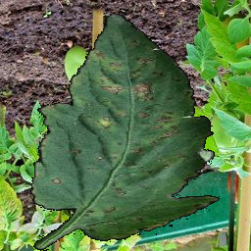
Sensitivity Analysis Datasets
Original dataset
Segmented dataset
Random Background
Crop dataset
Random Noise Background dataset
Random Noise Background dataset

Slide 11
Sensitivity Analysis Normal Train vs Segmented Test
Train
Test
Original dataset
Segmented dataset
Accuracy: 39.01%
Macro precision: NanN
Macro recall (Trues Rate): 28.58%
Falses Rate: 71.41%
Macro F1: NaN

Slide 12
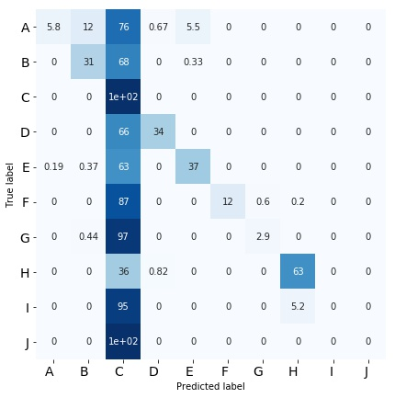
Sensitivity Analysis Normal Train vs Segmented Test
Bacterial Spot
Early Blight
Late Blight
Leaf Mold
Septoria Leaf Spot
Two-spotted Spider Mites
Target Spot
Tomato Yellow Leaf Curl Virus
Tomato Mosaic Virus
Healthy

Slide 13
Sensitivity Analysis Normal Train vs Normal Test Activation Visualization
Bacterial Spot Class
Late Blight Class

Slide 14
Sensitivity Analysis - Segmented Test vs Normal Train
Train
Test
Segmented dataset
Original dataset
Accuracy: 61.79%
Macro precision: 73.02%
Macro recall (Trues Rate): 49.41%
Falses Rate: 50.59%
Macro F1: 48.69%

Slide 15
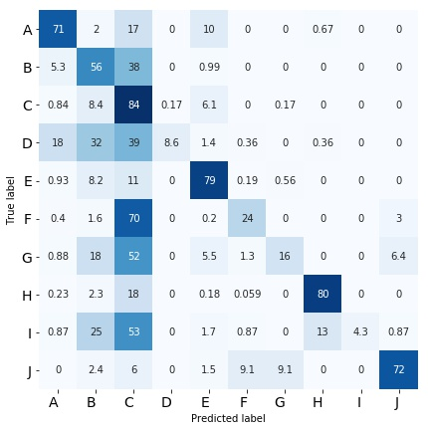
Sensitivity Analysis Segmented Train vs Normal Test
Bacterial Spot
Early Blight
Late Blight
Leaf Mold
Septoria Leaf Spot
Two-spotted Spider Mites
Target Spot
Tomato Yellow Leaf Curl Virus
Tomato Mosaic Virus
Healthy

Slide 16
Sensitivity Analysis Random Background Crop Train vs Normal Test
Train
Test
Random Background
Crop dataset
Original dataset
Accuracy: 76.92%
Macro precision: 76.92%
Macro recall (Trues Rate): 79.43%
Falses Rate: 32.70%
Macro F1: 67.15%

Slide 17
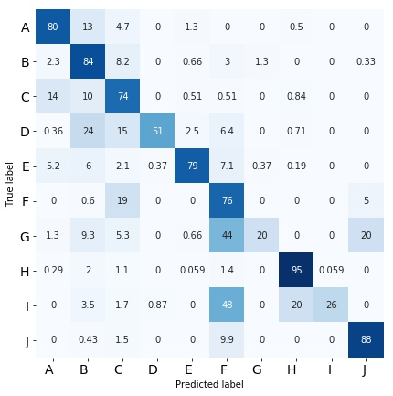
Sensitivity Analysis Random Background Crop Train vs Normal Test
Bacterial Spot
Early Blight
Late Blight
Leaf Mold
Septoria Leaf Spot
Two-spotted Spider Mites
Target Spot
Tomato Yellow Leaf Curl Virus
Tomato Mosaic Virus
Healthy

Slide 18
Sensitivity Analysis Random Noise Background Train vs Normal Test
Train
Test
Random Noise Background dataset
Original dataset
Accuracy: 57.89 %
Macro precision: 66.68%
Macro recall (Trues Rate): 49.01%
Falses Rate: 50.99%
Macro F1: 49.93%

Slide 19
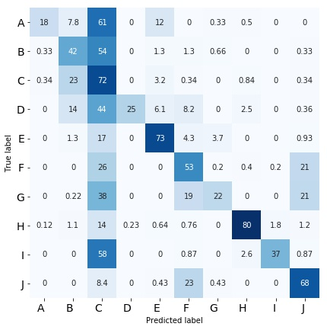
Sensitivity Analysis Random Noise Background Train vs Normal Test
Bacterial Spot
Early Blight
Late Blight
Leaf Mold
Septoria Leaf Spot
Two-spotted Spider Mites
Target Spot
Tomato Yellow Leaf Curl Virus
Tomato Mosaic Virus
Healthy

Slide 20
Sensitivity Analysis – Per Leaf Normalization Random Background Image Train vs Normal Test
Train
Test
Per Leaf Normalization
Random Noise Background dataset
Original dataset
Accuracy: 97.77%
Macro precision: 97.52%
Macro recall (Trues Rate): 96.69%
Falses Rate: 3.31%
Macro F1: 97.04%

Slide 21
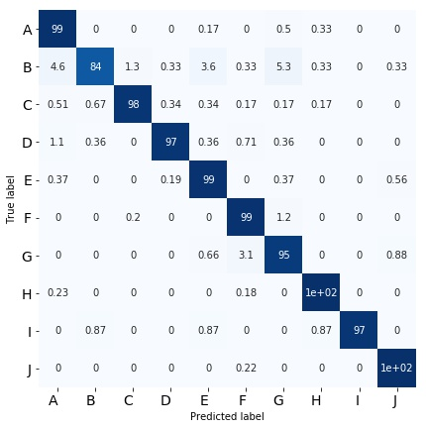
Sensitivity Analysis Random Background Image Train vs Normal Test
Bacterial Spot
Early Blight
Late Blight
Leaf Mold
Septoria Leaf Spot
Two-spotted Spider Mites
Target Spot
Tomato Yellow Leaf Curl Virus
Tomato Mosaic Virus
Healthy

Slide 22
Random Background Image Train vs Normal Test Activation Visualization
Bacterial Spot Class
Late Blight Class

Slide 23
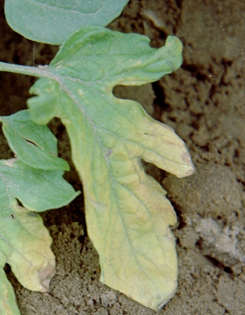
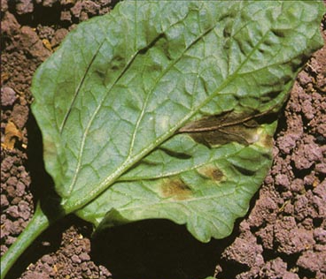
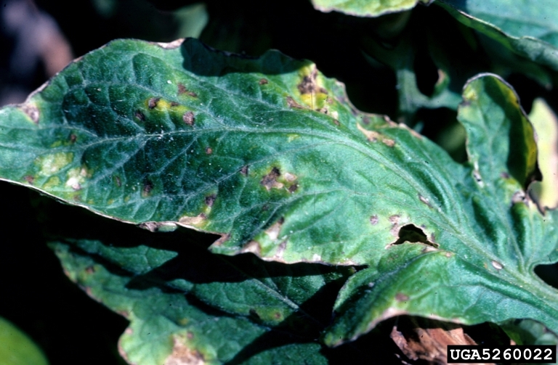
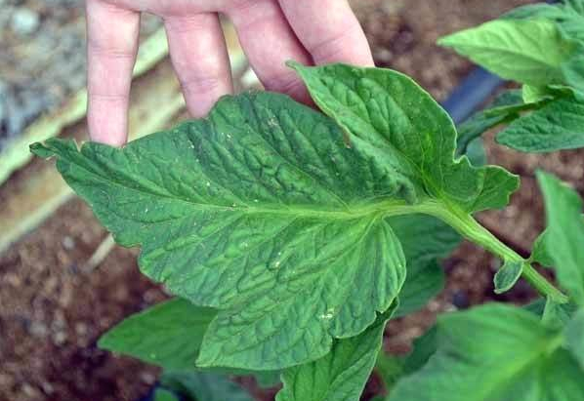
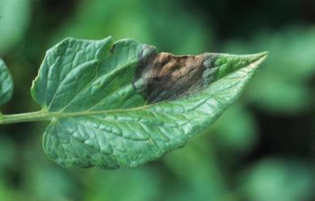
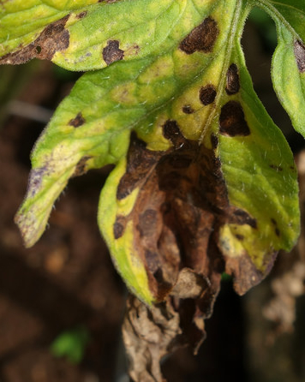
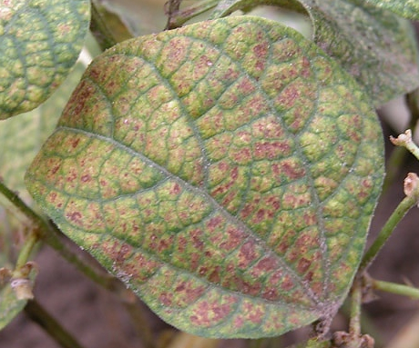
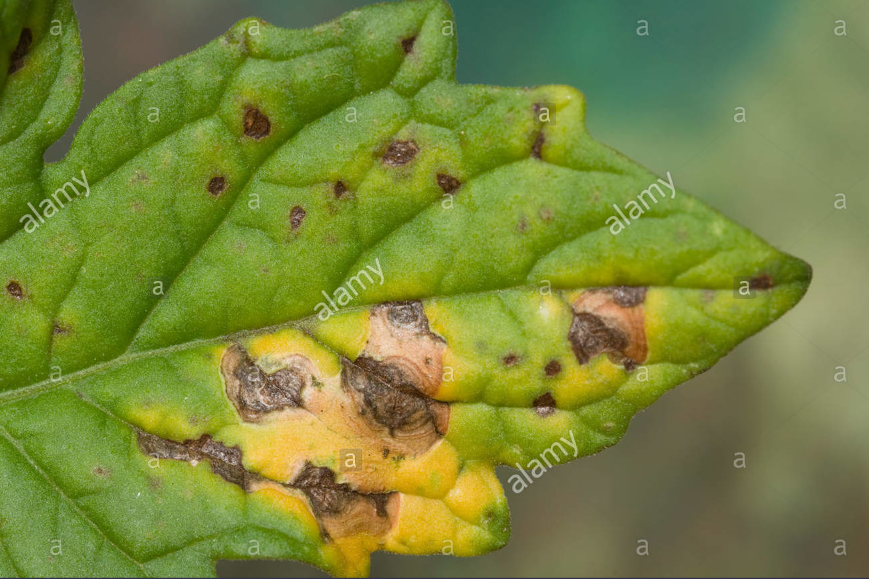
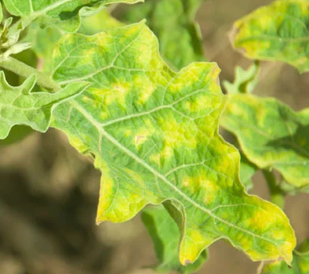
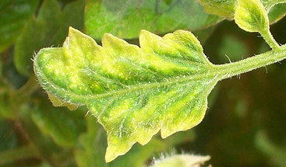
Extension: Test against Real Plantation Images
We built a set of 256 found on internet.
Bacterial Spot
26 samples
Early Blight
41 samples
Healthy
27 samples
Late Blight
31 samples
Leaf Mold
33 samples
Two Spotted Spider mite
12 samples
Target Spot
12 samples
Tomato Mosaic Virus
18 samples
Tomato Yellow Leaf Curl virus
29samples
Septoria leaf spot
36 samples

Slide 24
Test against Real Plantation Images Results
AlexNet
Accuracy: 29.81%
Macro precision: 30.36%
Macro recall (Trues Rate): 25.86%
Falses Rate: 74.13%
VGG11
Accuracy: 35.85%
Main Limitation: the set is not validated by a domain expert.

